Slide 1

Lecture 5: Fragments
WRPV302: Advanced Programming
Dr Simone Beets
Notes:
Reusing parts of the UI & functionality
https://developer.android.com/guide/fragments

Slide 2

Revision (L4) - Class exercise

Slide 3

Class exercise
You have 5 minutes…
Instructions:
Turn to 2 or 3 peers next to you & discuss your answers. Try answering from memory before using any resources…
Questions:
What is the difference between a View, a ViewGroup & a Layout?
The default strings.xml lives in res/values. Where would the Afrikaans version go & in what order does Android search for the right one?
How do you reference a string resource strHello (a) in the layout XML & (b) in Java code?
When a layout changes at runtime (e.g., rotation), what happens to the Activity?
Serializable vs Parcelable: which is (a) simpler to implement & (b) which is faster?

Slide 4

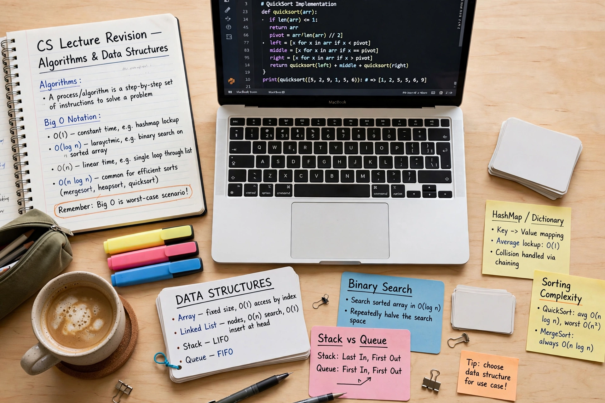

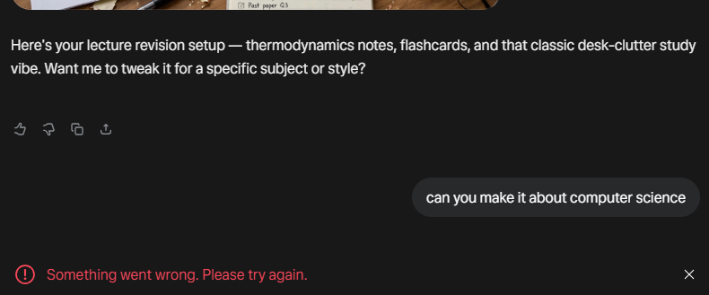

Slide 5
Q1. What is the difference between a View, a ViewGroup & a Layout?
View: anything on screen that the user interacts with
ViewGroup: a View that contains other Views
Layout: the XML file defining them
Notes:
View: anything that displays on the screen & user interacts with, e.g., TextView, Button, ImageView, etc.
ViewGroup: a type of View that can contain other Views (including other ViewGroups), e.g., LinearLayout & ConstraintLayout
Layout: usually XML files that define ViewGroups & the Views inside them

Slide 6
Q2. The default strings.xml lives in res/values. Where would the Afrikaans version go?
res/values-af
In what order does Android search?
most specific to least specific, takes the first match
Notes:
Same named file in different folders, where context specified by postfixes on default name, e.g., default res/values, then for Afrikaans it will be res/values-af
In what order does Android search?
When you need a specific value, look from most specific to least specific
Takes the first value found that matches the context

Slide 7
Q3. How do you reference a string resource strHello
in the layout XML
in Java code?
(a): @strings/strHello
(b): R.string.strHello

Slide 8
Q4. When a layout changes at runtime (e.g., rotation), what happens to the Activity?
the entire Activity is recreated
Notes:
why Activities must be self-contained

Slide 9
Q5. Serializable vs Parcelable —
(a) which is simpler
(b) which is faster?
(a): Serializable is simpler to implement
(b): Parcelable is faster & language-neutral, but needs more code

Slide 10

Fragments

Slide 11
What is a Fragment?
Represents a reusable portion of an app’s UI
Defines & manages its own layout, has its own lifecycle & can handle its own input events
Can’t live on its own, so it must be hosted by an Activity (or another fragment)
  Its view hierarchy then becomes part of / attaches to the host’s view hierarchy

Slide 12
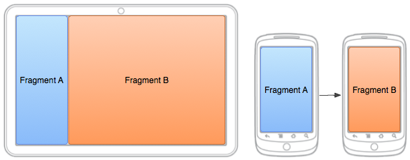
Why fragments?
Different devices
  Different resolutions & physical sizes
Problem?
  To write as little code as possible but support multiple devices
Solution?
  Break up into reusable parts
    Fragment: self contained (behaviour & layout)
    Fragment is contained in an Activity
    Different Fragment configurations for different devices
  Lifetime of contained Fragment is closely bound to Activity’s
Notes:
Activities are an ideal place to put global elements around your app’s UI (e.g., navigation drawer)
Fragments suited to define & manage UI of a single screen or portion of a screen
Allow you to divide your UI into different chunks
E.g., if your app responds to different screen sizes, then:
Larger screens: display a static navigation drawer & a list in a grid layout
Smaller screens: display a bottom navigation bar & list in a linear layout
So:
Separate navigation elements from content → process becomes more manageable
Activity is then responsible for displaying the correct navigation UI
Fragment displays the list with the proper layout
Advantages?
Dividing UI into fragments, makes it easier to modify the activity’s appearance at runtime

Slide 13
Activity stacks
New Activity
started
New Activity
Active Activity
LIFO stack of Activities
Top-most = active Activity
As new Activities are started (normally)
  Pushed onto stack
  Previous topmost becomes inactive
  New Activity becomes active
Back button pushed or activity closed
:
Last Active Activity
Removed to free resources
Activity Stack
Notes:
Android apps are built around Activities (screens)
Activities are managed using a back stack (lifo) – last opened is on top & visible
Opening a new Activity pushes it on the stack, then pressing back pops the last active Activity off
While the Activity is in the STARTED lifecycle state (or higher):
Fragments can be added, replaced or removed
Can also keep record of these changes in a back stack that is managed by the Activity
Can then reverse these changes
So just remember that Fragments live inside of Activities, so their lifetime depends on their parent Activity’s position in the stack

Slide 14
Activity states
Active
At top of stack
Is visible, focused, foreground Activity
Paused
Normally not visible; always not focused
Treated as active, but no user input events received
Android attempts to keep alive at all costs (will rather kill Activities lower on the stack to recover resources
Paused when another Activity becomes active
Killed in extreme circumstances to recover resources
Is stopped if becomes obscured
Stopped
Not visible
Remains in memory, retains state memory, but candidate for termination
NB saved data & current UI state
Inactive
After killed, before launched is inactive
Removed from stack & needs to be restarted before it will be displayed & be usable
Notes:
Fragments closely follow their parent Activity’s lifecycle – but also add their own fragment lifecycle methods

Slide 15
Activity states…
Activity.onCreate
Activity.onRestoreInstanceState
Activity.onStart
Activity.onResume
Activity.onSaveInstanceState
Activity.onRestart
Activity.onPause
Active Lifetime
Activity.onStop
Activity is killable
Visible Lifetime
Activity.onDestroy
Full Lifetime

Slide 16
Monitoring Activity state changes
Method | When triggered | What to do
onCreate | Start of full lifecycle | Initialise Activity & inflate UI
onRestoreInstanceState | Called after onCreate finished (only called if was killed since was last visible) | Restore UI state
onRestart | Called before subsequent visible lifetimes of Activity | Load changes, knowing has already been visible
onStart | Called at start of visible lifetime | Apply any required UI change now that Activity is visible
onResume | Called at start of active lifetime | Resume paused UI updates, etc. that were suspended when was inactive
onSaveInstanceState | Called to save UI state changes at end of active lifecycle | Save UI state changes.
onPause | Called at end of active lifetime | Suspend UI updates etc. that don’t need to be active when not foreground Activity
onStop | Called at end of visible lifetime (may be killed after this) | Suspend UI updates etc. not needed when not visible. Persist all edits or state changes.
onDestroy | Sometimes called at end of full lifecycle | Clean up resources (stop threads, close databases connections, etc.)

Slide 17
Fragments
Encapsulated, independent, reusable components
Own lifetime & UI
Allows dynamic & flexible UIs to be created
Each Fragment is tightly bound to Activity in which it is placed
  But can be reused/replaced
Typically follow lifetime of parent Activity
  But after that may follow own lifetime if added/replaced/removed dynamically from code
    Parent Activity provides a FragmentManager for managing contained Fragments
Notes:
Dynamic & flexible Uis
E.g., two-pane layout on a tablet (list on left, details on right) BUT only one fragment on a phone
But can be reused/replaced
Can use multiple instances of the same fragment class within the same activity, in multiple activities or as a child of another fragment
So, good practice:
Only have it contain the logic needed to manage its own UI
Avoid depending on or manipulating one fragment from another
Parent Activity provides a FragmentManager
Class responsible for performing actions on your app’s fragments (adding/removing/replacing them & adding back to stack) by managing the fragment back stack (within the context of the Activity)
Changes are committed together as a FragmentTransaction (& that’s what gets added to the stack)
If tapping the back button, top-most fragment transaction pops off the stack
If no more fragment transactions on the stack & not using child fragments, back event bubbles up to activity level
Activities are always stacked in the LIFO order
Fragments live inside Activities & you can choose to manage them in a back stack, but only if you explicitly add them to it
What if you don’t add the transaction to the fragment back stack?
Pressing back will just exit the activity (fragment change isn’t remembered)

Slide 18
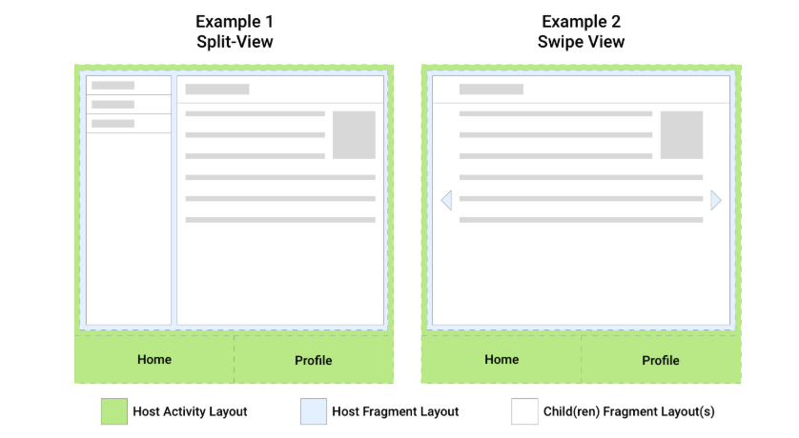
UI Example
Notes:
Green host, blue host fragment, white children fragments
Taken from https://developer.android.com/guide/fragments/fragmentmanager
Host Activity: displays top-level navigation to user (bottom)
Swaps out the host fragment with different screens in the app
Each screen is a separate fragment
Example 1: Host fragment hosts two child fragments (split-view screen)
Example 2: Host fragment hosts one child fragment (swipe view)
Host Activity & Host Fragment have a FragmentManager associated (manages child fragments)

Slide 19
Fragments
Can be added to parent Activity View either:
  In code:
    Need to load it manually
    But can dynamically swap Fragments in/out
  In XML (in Activity’s layout file):
    Loaded during inflation
    But cannot swap Fragment in/out
Do not appear in the manifest
Notes:
In code:
Can add/remove/replace fragments during runtime
Fragments don’t appear in the AndroidManifest.xml file, only Activities do

Slide 20
Fragment states
Created Lifetime
Fragment.onAttach
Fragment.onDetach
Fragment.onCreate
Fragment.onDestroy
Fragment.onCreateView
Fragment.onDestroyView
Fragment returns to layout from back stack
Fragment.onActivityCreated
Visible Lifetime
Fragment.onStart
Activity.onStop
Active Lifetime
Fragment.onResume
Fragment.onPause
Notes:
Each fragment instance has its own lifecycle
Fragments go through different states in their lifecycle depending on how the user navigates/interacts with your app
Fragments also have lifecycle callbacks: onCreate, onStart, onResume, onPause, onStop & onDestroy (callback methods)
Tie into Activity’s lifecycle but can also be independently managed
FragmentManager also responsible for attaching fragments to host activity & detaching when no longer in use (onAttach/onDetach)
onAttach: invoked when fragment added to a FM & attached to host Activity (fragment is active & can be retrieved using findFragmentById())
Called before any lifecycle state changes
onDetach: invoked when fragment is removed from a FM & is detached from its host Activity (no longer active & can’t be retrieved using findFragmentById())
Always called after any state changes

Slide 21
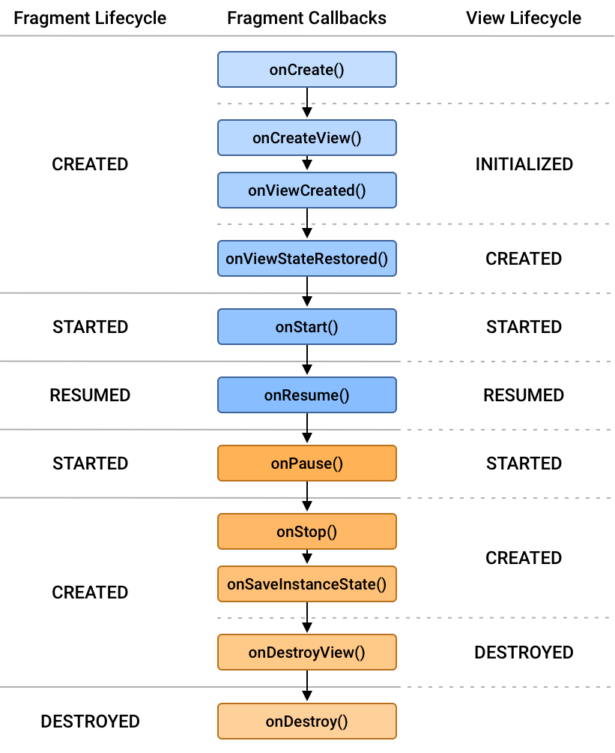
Fragment lifecycle
Notes:
Fragment lifecycle from Android documentation
https://developer.android.com/guide/fragments/lifecycle

Slide 22
Monitoring Fragment state changes
Method | When triggered | What to do
onAttach | Called when attached to parent Activity | Get reference to parent Activity
onCreate | Called to initialise creation on Fragment | Initialise Fragment (not UI!!)
onCreateView | Called on created, so that UI can be created | Create/inflate UI in provided container
onCreatedView | Called after the fragment’s Views created and initialised | Obtain references to Views, set initial values
onActivityCreated | Called after Activity & Fragment UI created | Complete initialisation, esp. anything needing parent Fragment to be fully inflated
onStart | Called at start of visible lifetime | Apply any required UI change now that visible
onResume | Called at start of active lifetime | Resume paused updates etc. that were suspended
onPause | Called at end of active lifetime (Often killed after this) | Suspend updates etc. Persist edits/state changes.
onStop | Called at end of visible lifetime | Suspend remaining updates etc. not required when not visible
onDestroyView | Called when is being detached | Clean up resources related to Fragment’s View
onDetach | Called once detached from parent Activity
onDestroy | Called at end of lifetime | Clean up resources related to Fragment, e.g., database connections
Notes:
Important to know which callback to use for what (e.g., inflating the UI in onCreateView)

Slide 23
Steps required to include a Fragment
Create Fragment layout [New → Fragment → Fragment (Blank)]
Create Fragment class
    Inflate layout in class’s onCreateView event handler (not onCreate)
Create Activity layout
    Add Fragment in XML OR place container into which Fragment will be placed
Create Activity class
    If Fragment was not added to the Activity layout, then manually add Fragment to a container in onCreate (& other methods if needed)
Notes:
Create a fragment layout XML.
Create a fragment class extending Fragment, inflate layout in onCreateView.
Update Activity layout (either include fragment in XML or leave space for dynamic insert).
Add code in Activity to manage fragments if not static.
Here is where FragmentManager & FragmentTransaction are used.

Slide 24
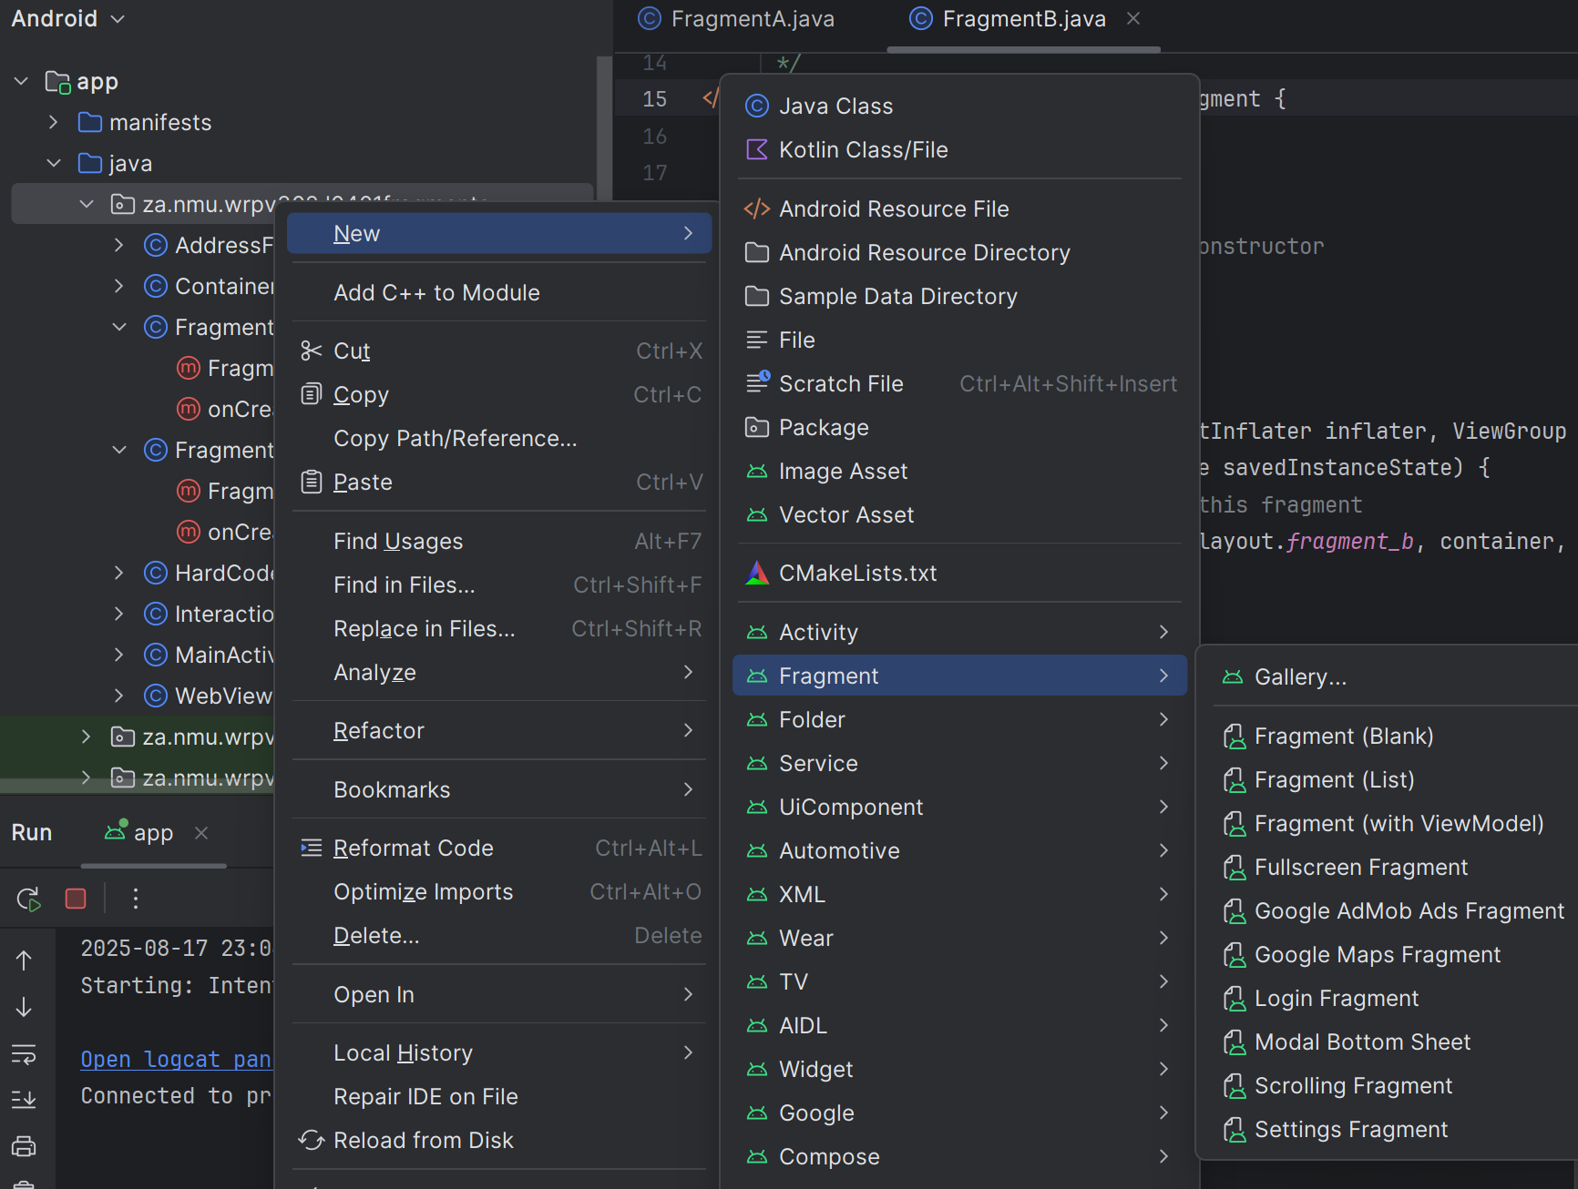
Steps required to include a Fragment
Notes:
Create a fragment layout XML.
Create a fragment class extending Fragment, inflate layout in onCreateView.
Update Activity layout (either include fragment in XML or leave space for dynamic insert).
Add code in Activity to manage fragments if not static.
Here is where FragmentManager & FragmentTransaction are used.

Slide 25
See (1) in class example for inserting a Fragment into an Activity layout

Slide 26
See (2) in class example for manually adding/replacing Fragments to/in an Activity
Considered good practice to include any View containers contained in any transactions in all layout variations

Slide 27
Communication
Activity (container)
Activity → Fragment
  Notify Fragment of something interesting in Activity
    Could have a Fragment listen to an Activity, but since the Activity has a reference to the fragment, it is not necessary
  Activity obtains reference to contained Fragment & calls method on it
  Can send through parameters when creating Fragment in a Bundle
1
Fragment_{A}
1
Fragment_{B}
Notes:
Sometimes an Activity needs to tell a Fragment something
E.g., user logged in, so need to update fragment UI
Activity holds a reference to the fragments, it can call public methods directly on them
Can also send arguments to a fragment via a Bundle when creating it

Slide 28
Communication
Activity (container)
Fragment → Activity
  Notify Activity of something interesting happening in Fragment
  Define interface that Activity implements, i.e., listeners (from last semester)
  Call interface method(s) when something occurred, i.e., notify listeners when something interesting happens
  See (3) in class example
2
Fragment_{A}
2
Fragment_{B}
Notes:
Other way
Fragment needs to tell Activity something happened, e.g., user clicked something
Define an interface in the fragment that the Activity implements
When the event occurs, the fragment calls the interface method (Activity responds)
So the fragment remains reusable (as it doesn’t depend on a specific Activity)
The Fragment defines a listener interface
Any Activity hosting the fragment must implement that interface
Fragment doesn’t care which Activity it is in, as long as it implements the contract
Fragment is loosely coupled & can be dropped into different Activities without modification

Slide 29
Communication
Activity (container)
Fragment ←→ Activity
  Each Fragment has communication interfaces (for callbacks) as needed
    i.e., have each fragment listen to the other fragment
  Initial linking between fragments done by Activity
  Alternatively, Activity acts as intermediary between Fragments
Could use publish-subscribe pattern*
  No references required between Activity & Fragments (de-coupled)
Could use ViewModel
3
Fragment_{A}
3
Fragment_{B}
1
2
3
Notes:
* Assignment 2
Fragments shouldn’t communicate directly with one another (for decoupling)
Activity acts as a mediator
E.g., in a table app with 2 fragments (say the list and details example from before),
The list fragment notifies the Activity
The Activity updates the details fragment
Can also use a shared ViewModel or publish-subscribe pattern for communication

Slide 30
Assignments & tasks
Assignment 2:
Due – 25 August 2026
Peer reviews – that Friday
Module evaluation:
Uploaded to Funda
Due – 27 August 2026

Slide 31
Questions to the interviewer…
Notes:
Have your own question to the interviewer ready
Shows interest
My go to: What does a typical day look like for someone in this role?
What does success look like in the first 3/6 months?
What characteristics/traits/skills do you think a good [insert role] should have to be successful for this role?
How is the team made up?
Maybe Interested in tech stack and not let you know yet

